Slide 1

Fitness Progress Monitoring Dashboard with Chatbot Support
Made By: Pulkit Srivastava

Slide 2






Agenda
In today’s fast-paced and health-conscious society, fitness has become a crucial aspect of daily life. With growing awareness of the benefits of physical and mental well-being, more people are striving to lead active, healthier lifestyles. However, balancing busy schedules with consistent fitness routines can be difficult, making it hard to stay on track with personal health goals.
Fitness trackers offer a practical solution to this challenge. These smart tools empower individuals to take control of their health by providing real-time data, personalized insights, and motivation to stay active and committed to their fitness journey.
Problem Statement
Proposed Solution
Technology Stack
Screenshots
Code Snippets
Q&A
1
2
3
4
5
6

Slide 3
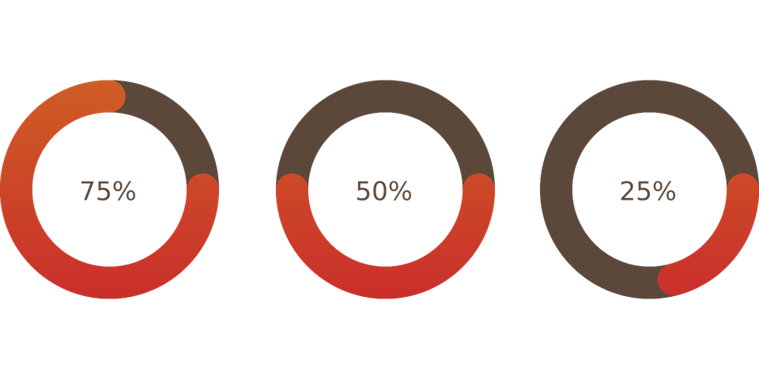
Problem Statement
Fitness centers, gyms, and personal trainers often face challenges in tracking client progress, managing personalized workout routines, and keeping users engaged consistently

Slide 4
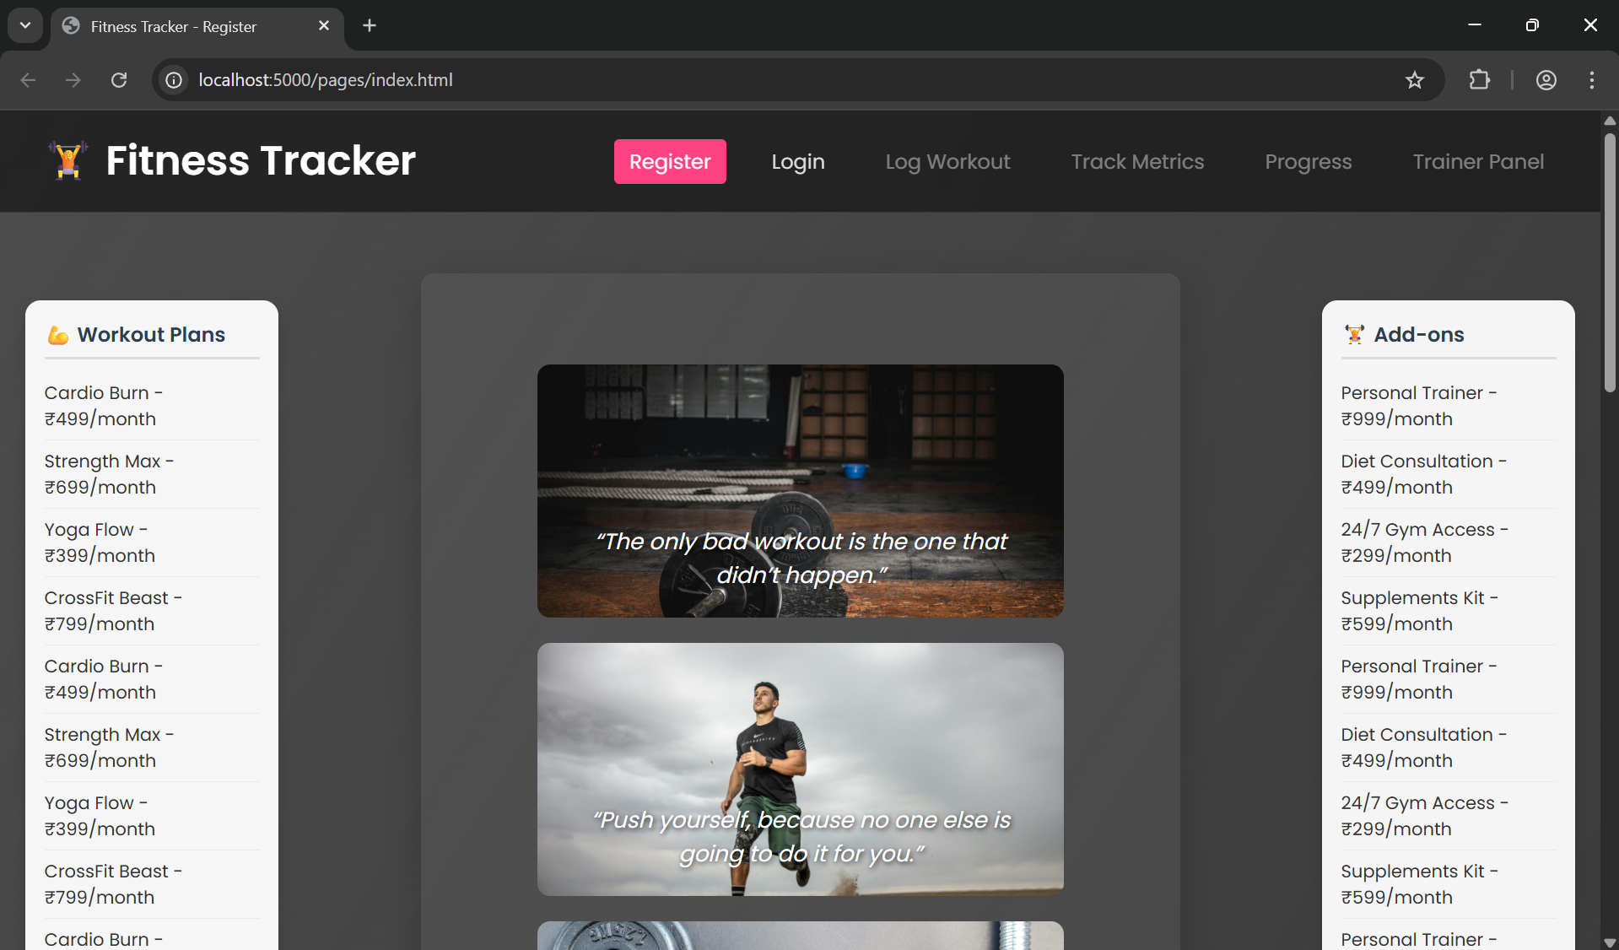
Proposed Solution
To meet the rising demand for effective personal fitness management and goal tracking, this project introduces a fitness tracker application. It allows users to actively monitor their workouts and health data in a structured, interactive way.
Built using HTML, CSS, JavaScript, Node.js, and MongoDB, the system is centered around four key modules: User Management, Workout Logging, Progress Tracking, and a dedicated Trainer Panel.
User Management Features:
User Registration: New users can sign up by entering their personal details along with a fitness objective such as “Weight Loss” or “Muscle Gain.”
Secure Login: Returning users can log in securely using their credentials. The system maintains session tracking for logged-in users.
Trainer Access: Trainers can log in separately and are provided with tools to assign customized training plans to their clients, enhancing the personalization of fitness journeys.

Slide 5





Tech Stack
HTML: For the structure of the website
CSS: For the styling of the files
JavaScript: For validation of the different files
NodeJS: To run server-side scripting
MongoDB: Used for Database storage

Slide 6
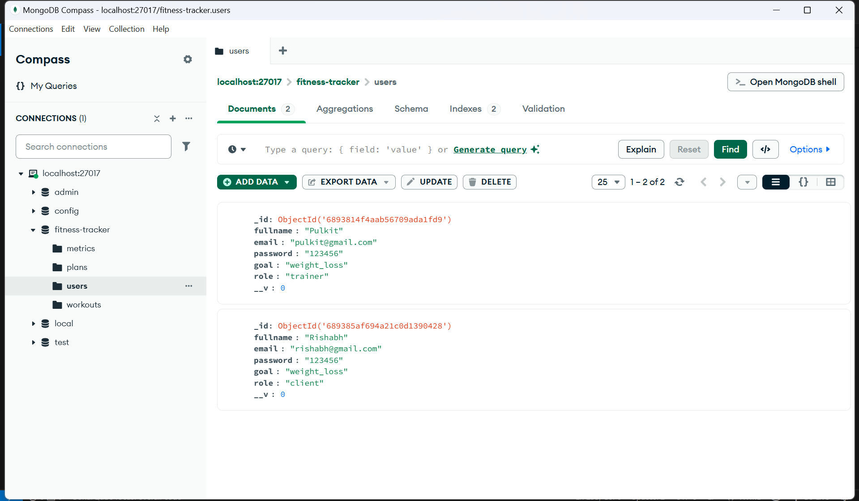
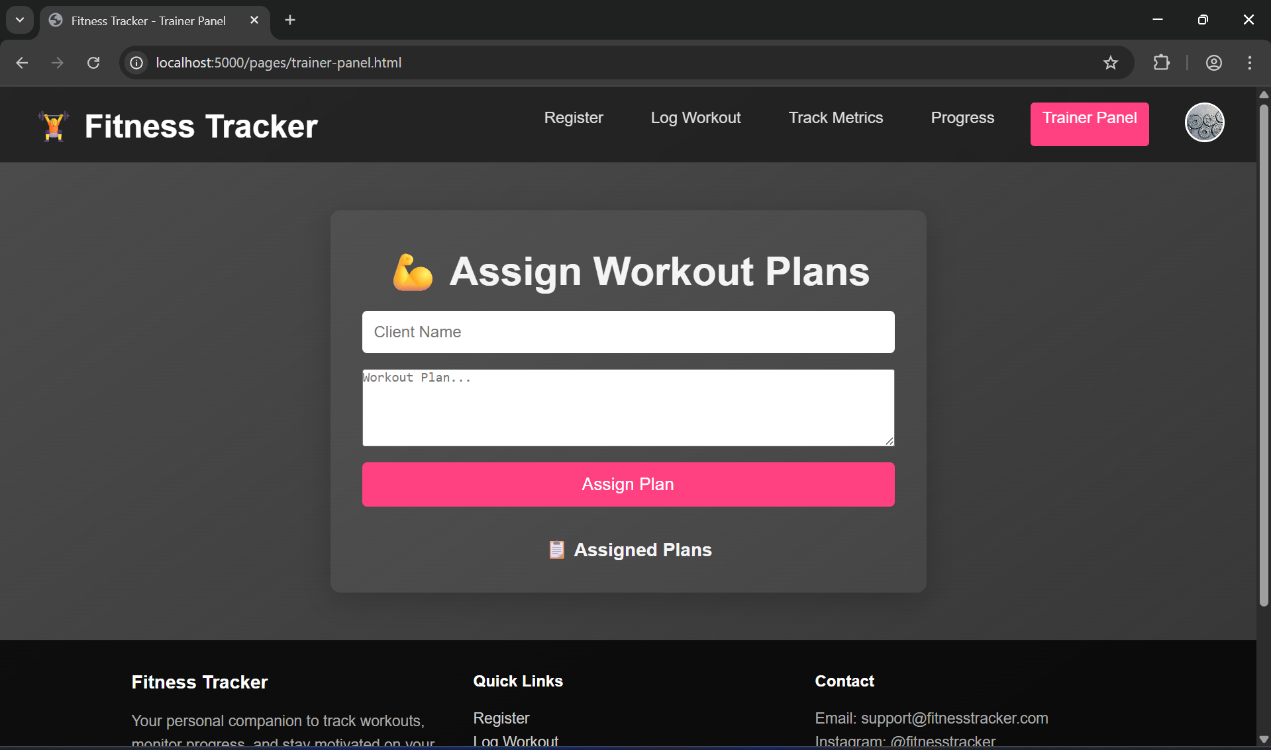
Screenshots

Slide 7
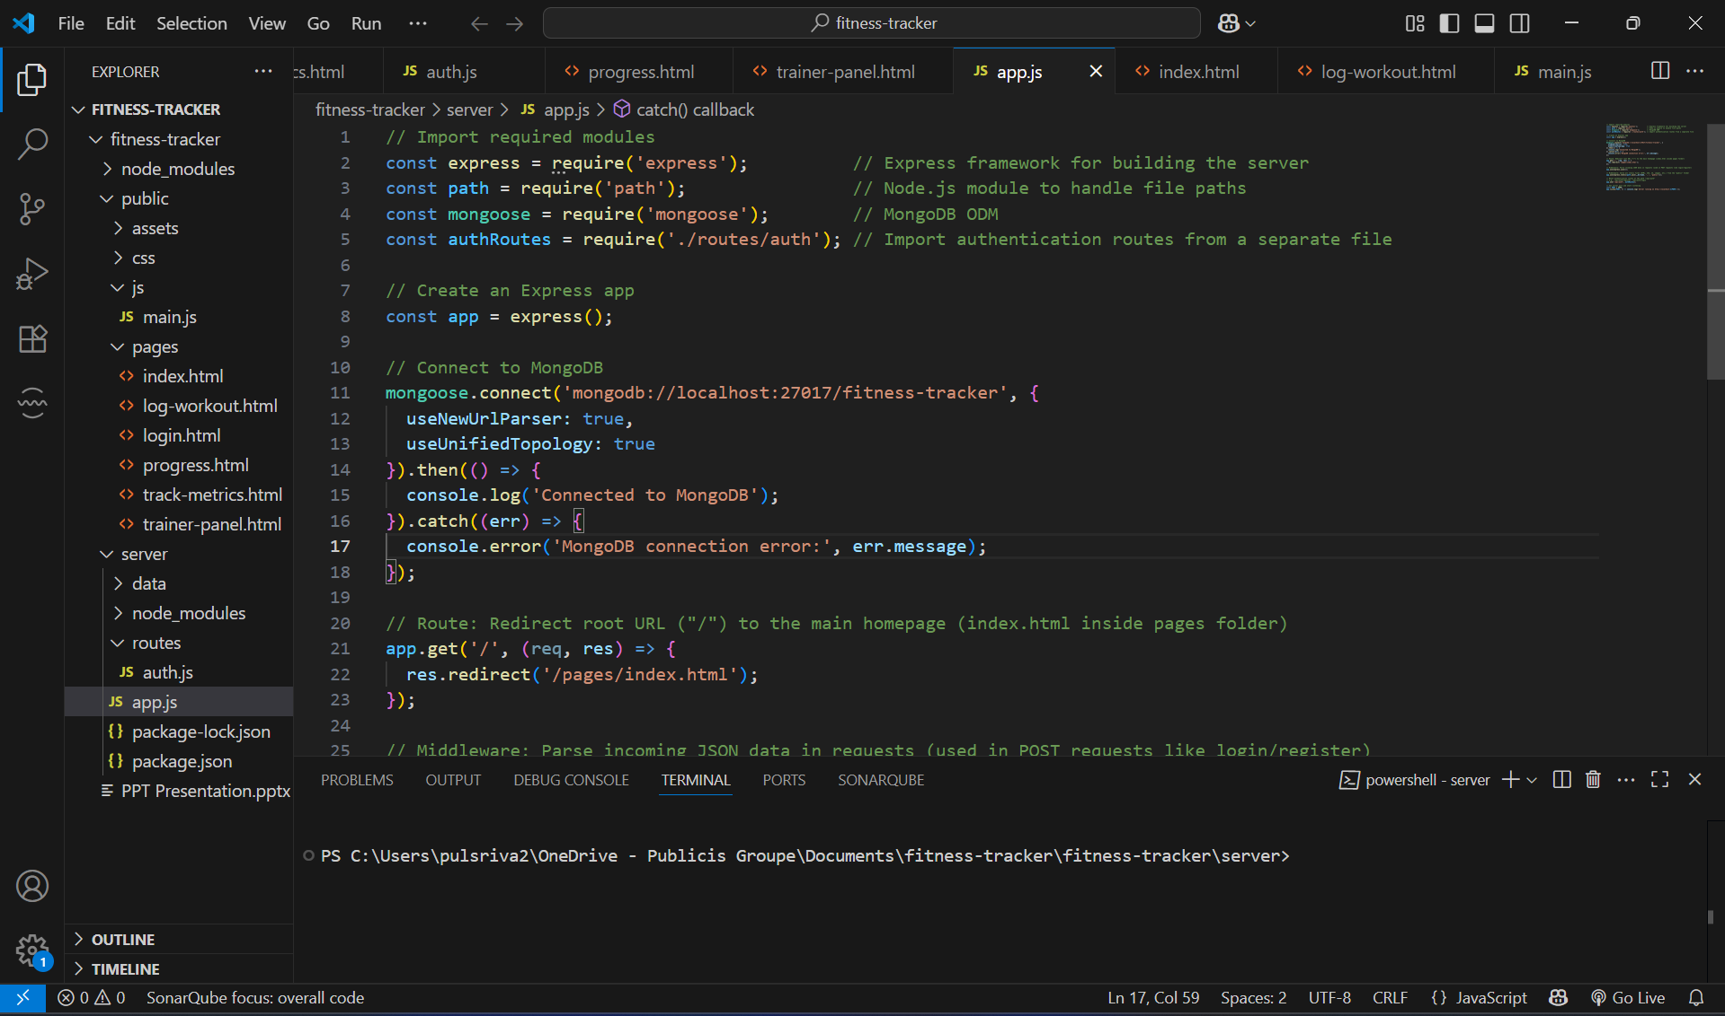
Code Snippets

Slide 8
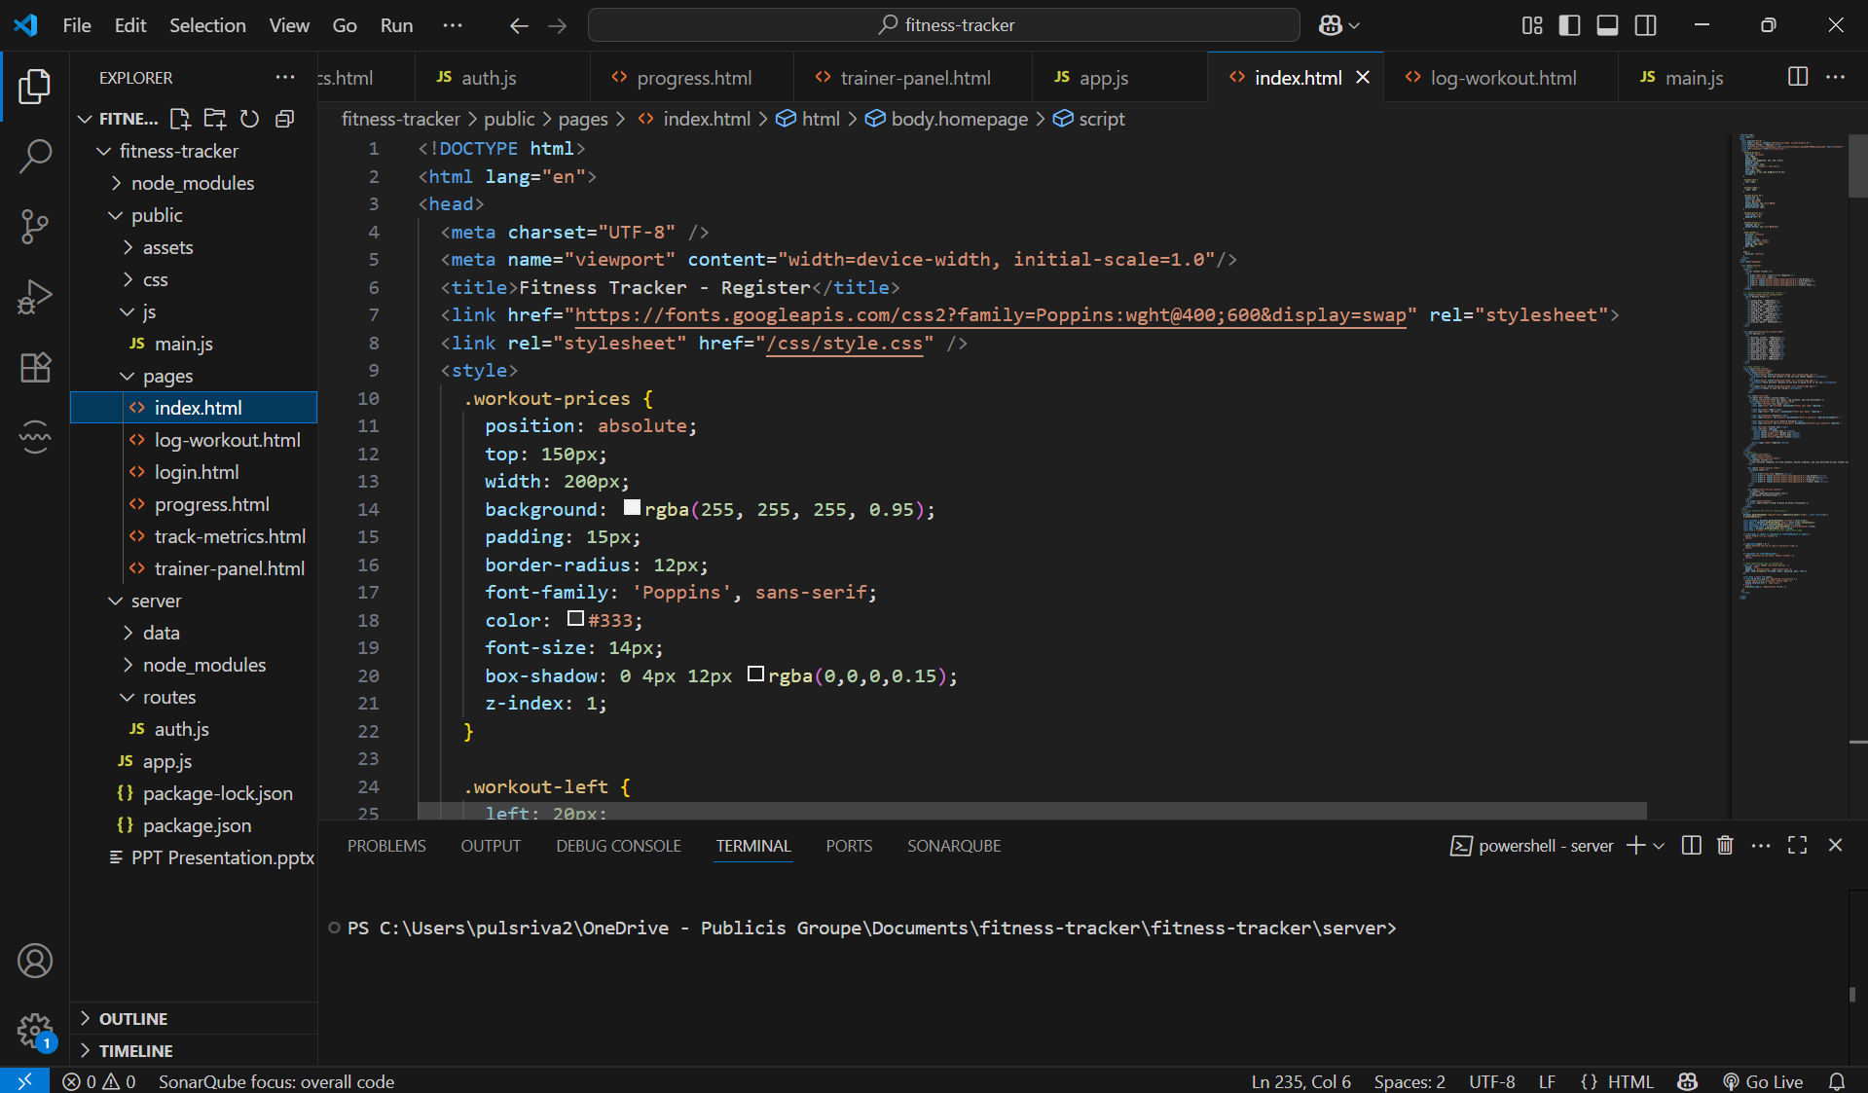
Code Snippets

Slide 9
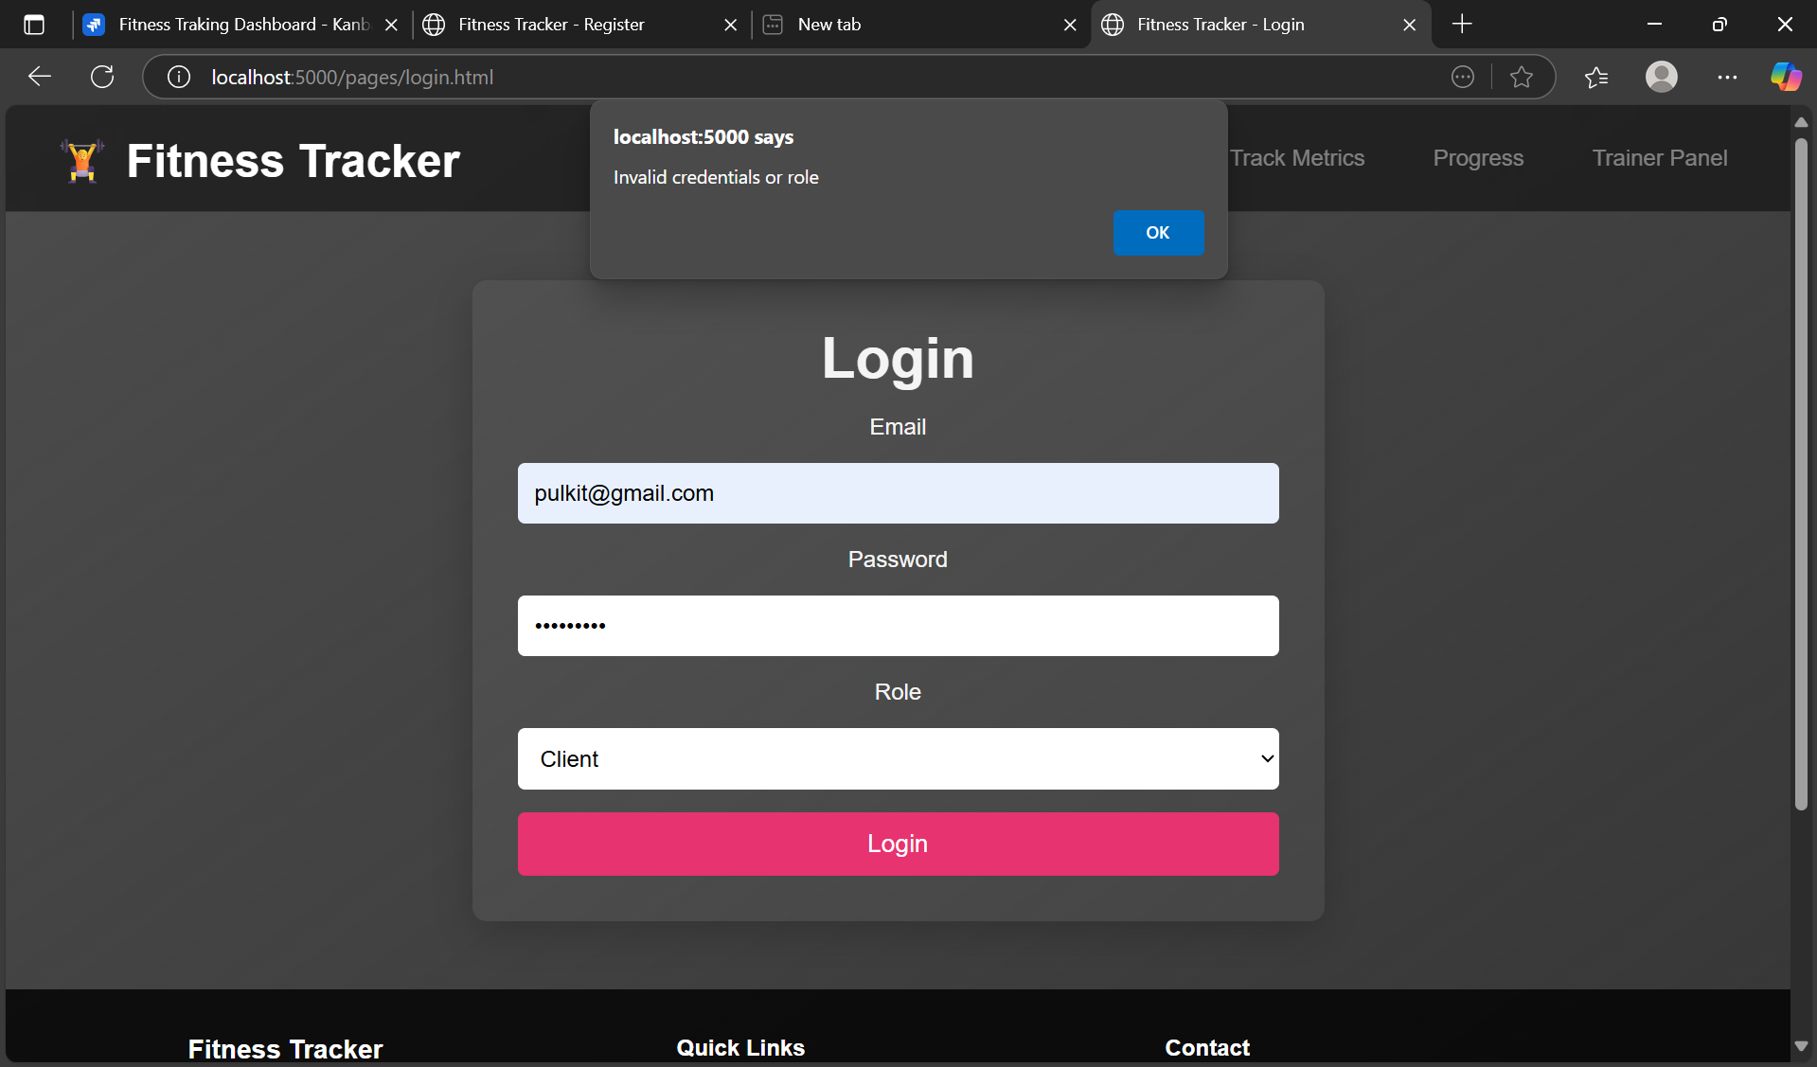
Test Cases
If the user puts invalid credentials

Slide 10
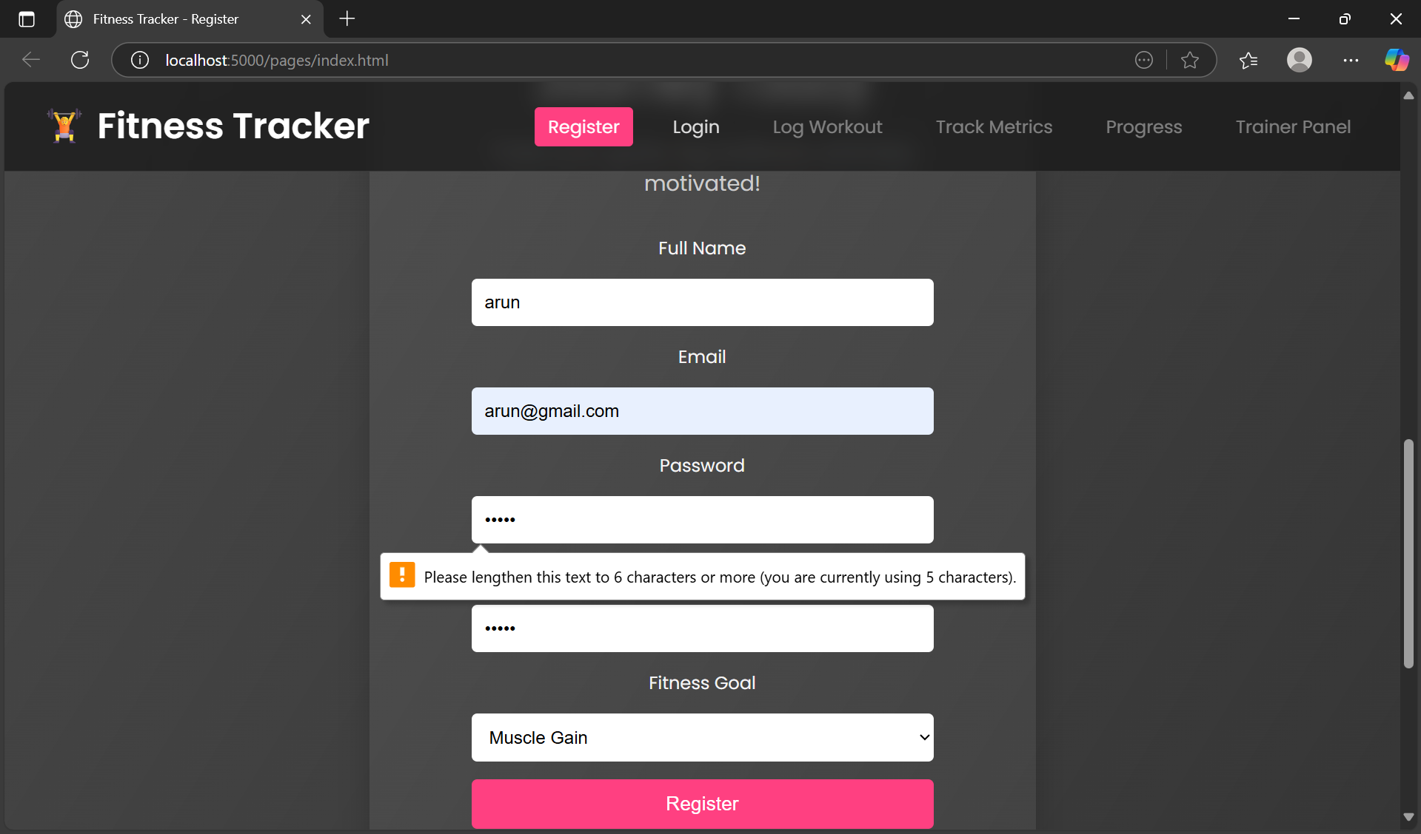
Test Cases
If the user puts password less then 6

Slide 11
Thank you

Slide 12
Q&A

